Slide 1
Serving Customers with Disabilities
Tools for Success

Slide 2
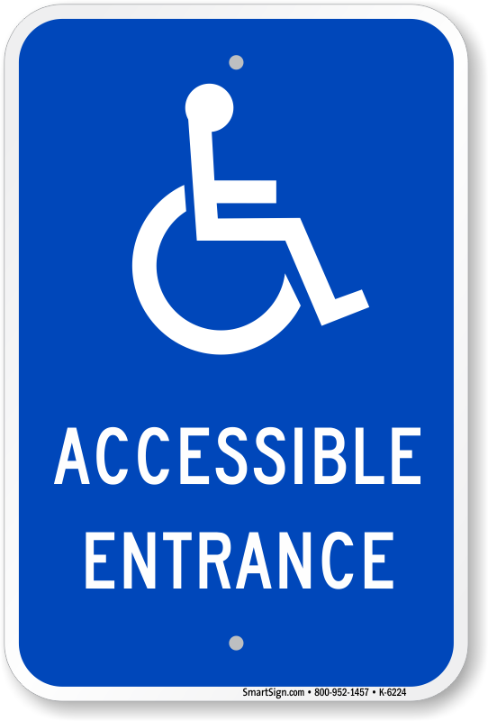
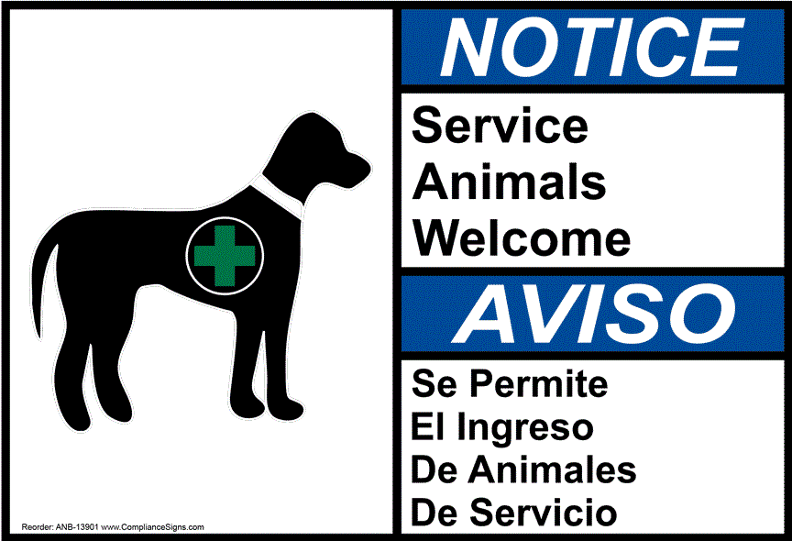
Welcome!
This training is designed to help you interact more comfortably with customers with disabilities

Slide 3
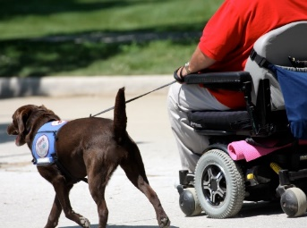
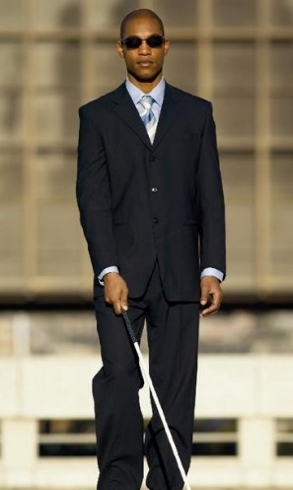
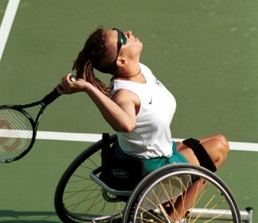
Did You Know?
1 out of 5 Americans has a disability
Many disabilities are not obvious
You wouldn’t typically know that a person has a cognitive disability, an autoimmune disorder, or chronic pain

Slide 4
Disability and Aging
The physical and mental limitations we experience as we get older can also be considered disabilities
With so many kinds of disabilities, you probably interact every day with someone who is disabled

Slide 5
The Primary Obstacle
The primary obstacle to full participation for people with disabilities is an inaccessible world
You can help change this by improving the hospitality of your business, organization, or agency
It all starts with providing exemplary customer service

Slide 6
The Most Important Habits
Excellent customer service is based on two habits:
Focusing on the person rather than the disability
Not making assumptions about what a person needs

Slide 7
Focus on the Person
A disability is a personal characteristic, just like race, gender, ethnicity, or sexual orientation
Just like these other characteristics, disability shouldn’t have any effect on the way we interact with customers

Slide 8
Don’t Make Assumptions
People with disabilities are diverse; it’s impossible to predict what any single individual might need or might not need
Rely on individuals to let you know what they need

Slide 9
Equal Treatment
In most situations, the way you treat a person with a disability should be the same as the way you treat a person without a disability
For example, if you normally ask customers without disabilities if they need help, then you may ask customers with disabilities the same question

Slide 10
Be an Observer
Just like you would with any other customer, observe a person with a disability when she enters your business
If someone appears to need something out of the ordinary, it’s okay to offer help
For example, if someone looks lost or confused, or is struggling to reach an item, she may appreciate an offer of assistance

Slide 11
Follow the Customer’s Lead
If your offer of assistance is accepted
Ask the customer how you can help
Follow the customer’s instructions

Slide 12
Talking About People with Disabilities
Are you ever confused about what kind of words and terms to use when talking about people with disabilities?

Slide 13
Person-First Language
Person-first language puts the person first; for example:
Person with a disability
Woman who has autism
Customer who is blind

Slide 14
Identity-First Language
Identity-first language puts the disability first as a mark of identity; for example:
Disabled person
Autistic woman
Blind customer

Slide 15
Person-First or Identity-First?
So, which one should you use?
There’s no “always right” answer, but person-first language is usually acceptable
When speaking with or about specific individuals, follow their preference

Slide 16
Avoid Offensive Language (Even if You Hear People with Disabilities Use It!)
Avoid terms that victimize or dehumanize people
For example: afflicted with or suffers from [a disability], wheelchair-bound or confined to a wheelchair
Avoid outdated terms
For example: handicapped, deaf and dumb, crippled, lame, retarded, spaz, psycho, nuts
Avoid trendy, sugar-coated terms
For example: differently-abled, challenged, or handi-capable

Slide 17
What to Say?
Instead of …
Say …
Handicapped (person), cripple, invalid
Handicapped (parking, restroom, etc.)
Deaf and dumb (or deaf mute)
Retarded, feeble-minded
Lunatic, psycho, nuts
Person with a disability
Accessible
Deaf
Person with an intellectual disability
Person with a psychiatric disability

Slide 18
Tips for Successful Interactions

Slide 19
Customers with Intellectual Disabilities
Speak to customers with intellectual disabilities the same way you would any other customers
If you are not understood the first time, try using different words to make your meaning clearer
If you are unable to communicate effectively after several tries, it’s okay to politely bring in your supervisor

Slide 20
Customers with Speech Disabilities
You might also have difficulty communicating with a customer who has a speech disability
If you don’t understand after a few tries, ask the customer if there are alternative methods you can use to communicate

Slide 21
Customers with Speech Disabilities, continued
People who have stutters or speech blocks usually prefer to finish their own sentences
Instead of trying to suggest a word or finish a sentence for a customer who is stuttering, wait for him to finish on his own

Slide 22
Customers Who Are Deaf
When communicating with a deaf person through an interpreter, it is important to look directly at the deaf person, not at the interpreter
This might be difficult at first; your gaze may be naturally drawn toward the interpreter
Don’t worry if this happens, simply direct your eyes back to the customer

Slide 23
Alternative Methods
If there is no interpreter, you might need to write notes, so have pen and paper available
Some customers might be able to read your lips, so speak clearly and make sure your mouth is visible

Slide 24
When to Speak Loudly
Many people with hearing loss still communicate through hearing, and may ask you to speak more loudly
It’s okay to speak more loudly if a customer asks you to

Slide 25
Customers Who Are Blind
When interacting with a blind customer, look at and speak to him, even if he is with another person
In fact, always speak directly to the customer regardless of the type of disability!

Slide 26
Physical and Verbal Guidance
If a customer who is blind or has low vision wants physical guidance, ask how you may guide her
If she wants verbal guidance, remember to give directions from her perspective (e.g., your “right” might be her “left”)

Slide 27
Other Services
You might need to read receipts, help fill out documents, assist with self-serve items, or provide information in large print, braille, or electronic formats for individuals with vision disabilities

Slide 28
Customers with Mobility Disabilities
Mobility disabilities include conditions that limit a person’s strength, stamina, or movement, and affect things like standing, walking, bending, climbing, sitting, reaching, grasping, lifting, etc.

Slide 29
Invisible Mobility Disabilities
Some mobility disabilities are not obvious, for example:
A heart condition might limit stamina and affect a person’s ability to climb stairs or walk long distances
The pain and stiffness of arthritis might limit the ability to grasp, hold, or lift objects

Slide 30
Conversation Etiquette
If you are speaking for more than a moment with a customer who uses a wheelchair, sit down if a chair is available, or step back a couple of paces so he doesn’t have to strain his neck to look up at you

Slide 31
Accessible Paths and Areas
Be aware of accessible paths through your place of business and keep them clear
If you have service desks and counters that are too high for wheelchair users, be prepared to offer alternatives such as clipboards or lower tables

Slide 32
Customers of Short Stature
Some of these principles also apply to interacting with customers of short stature
Position yourself in a way that makes it easy for them to look at you, and be sure to work around high desks and counters that might not be usable for them

Slide 33
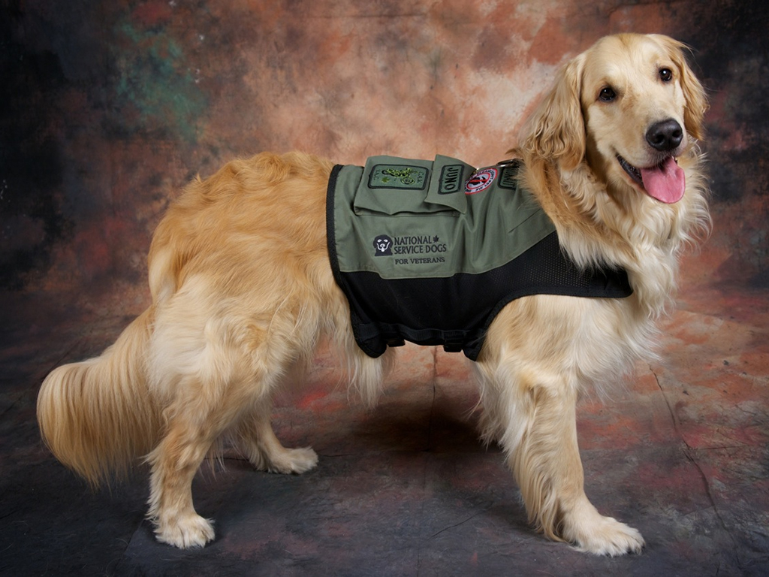
Service Dogs
Many customers with disabilities use service dogs, so knowing a little bit about them will help your customer service

Slide 34
A Service Dog Can…
You may be familiar with service dogs that guide people who are blind or have low vision, but did you know service dogs do many other jobs?
Service dogs can:
Retrieve items such as medicine or the telephone
Pull a wheelchair
Provide physical support and help with balance
Prevent or stop impulsive behaviors through positioning, applying pressure, etc.
Detect and alert individuals to allergens, sounds, oncoming seizures, etc.

Slide 35
Service Dog Rules
Service dogs are allowed in your business even if you have a “no animals” policy
Service dogs are working, so don’t pet, feed, or distract them
Service dogs must be housebroken and under the customer’s control at all times

Slide 36
Service Dog or Emotional Support Dog?
Service dogs must be trained to perform specific actions, tasks, or work
Many animals provide comfort or emotional support, but if they are not trained to do anything specific the ADA does not require you to allow customers to bring them into your place of business

Slide 37
The Two Questions
If the task or work a dog performs is not obvious, there are two questions you can ask the customer
Is this dog required because of a disability?
What work or task has this dog been trained to perform?

Slide 38
What You May Not Ask
You may not ask for documents, certificates, details, or proof of either the customer’s disability or the dog’s training

Slide 39
Take-Aways
People with disabilities are eager to receive the services you provide
The most important things to remember:
Customers with disabilities should be treated with the same courtesy, patience, and respect as other customers
Follow the customer’s lead when it comes to preferred language, methods of communication, or providing help

Slide 40
Questions?
Call or visit us online
Mid-Atlantic ADA Center 800-949-4232 (DC, DE, MD, PA, VA, WV) www.ADAinfo.org Operated by TransCen, Inc.

